Slide 1
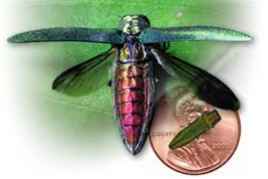
EMERALD ASH BORER (EAB)
Presented by:
Luke Mahal
Tree Savvy LLC
Eleva, WI 54738
(715) 797-5641

Slide 2
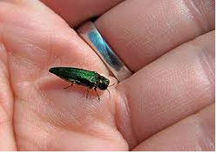
What is the EAB?
Agrilus planipennis, commonly known as the emerald ash borer, is a green jewel beetle native to eastern Asia that feeds on ash species. In its native range, it is typically found at low densities and is not considered a significant pest.

Slide 3
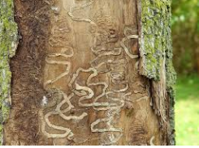
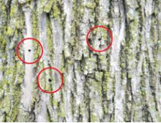
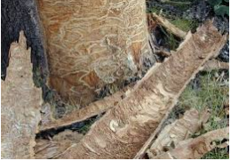
How Do I Know If My Trees Have EAB?
The symptoms an ash tree shows when it is infested with emerald ash borer are similar to symptoms caused by other ash pests or diseases in Wisconsin. For example, crown dieback can occur due to EAB damage, but can also be the result of drought stress, soil compaction or verticillium wilt, just to name a few.

Slide 4
Symptoms of EAB
Crown dieback: Dieback of the upper and outer crown begins after multiple years of EAB larval feeding. Trees start to show dead branches throughout the canopy, beginning at the top. Larval feeding disrupts nutrient and water flow to the upper canopy, resulting in leaf loss. Leaves at the top of the tree may be thin and discolored. An example of this is shown below. Epicormic Sprouting: When trees are stressed or sick, they will try to grow new branches and leaves wherever they still can. Trees may have new growth at the base of the tree and on the trunk, often just below where the larvae are feeding. An example of this is shown in the picture above, where small branches are growing on the trunk, about 6 feet off the ground. Bark splits: Vertical splits in the bark are caused due to callus tissue that develops around larval galleries. Larval galleries can often be seen beneath bark splits. Woodpecker feeding: Woodpeckers eat emerald ash borer larvae that are under the bark. This usually happens higher in the tree where the emerald ash borer prefers to attack first. If there are large numbers of larvae under the bark the woodpecker damage can make it look like strips of bark have been pulled off of the tree. This is called "flecking." An example of this is shown below.

Slide 5
Signs of EAB
D-shaped emergence holes: As adults emerge from under the bark they create a D-shaped emergence hole that is about 1/8 inch in diameter. S-shaped larval galleries: As larvae feed under the bark they wind back and forth, creating galleries that are packed with frass (larva poop) and sawdust and follow a serpentine pattern. Larvae: Larvae are cream-colored, slightly flattened (dorso-ventrally) and have pincher-like appendages (urogomphi) at the end of their abdomen. By the time larvae are done growing they are 1 1/2 inches long. Larvae are found feeding beneath the bark. Adults: Adult beetles are metallic green and about the size of one grain of cooked rice (3/8 - 1/2 inch long and 1/16 inch wide). Adults are flat on the back and rounded on their underside.

Slide 6
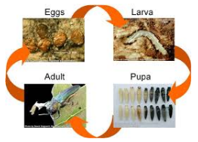
What does EAB look like?
EAB looks different in each of its four life stages Adult (beetle) Emerald ash borer adults are very small, metallic green beetles. They are about the size of a cooked grain of rice: only 3/8 - 1/2 inch long and 1/16 inch wide. Adult emerald ash borers emerge from beneath the bark of ash trees late May through mid-July. They create a D-shaped exit hole as they chew their way out of the tree. The beetles are most active during warm and sunny days. They never wander far from where they exit a tree (less than one mile) in search of a mate. Once they find a mate, the female will lay 60 - 90 eggs, one at a time, in the crevices of ash tree bark. The beetles will feed lightly on ash tree leaves, but do not cause much harm that way. EAB beetles live a total of three to six weeks. Egg Emerald ash borer eggs are very small (1 mm), difficult to find and are rarely seen. Female beetles deposit them in bark crevices and as larvae hatch from the egg, they immediately chew their way into the tree. Larva (immature EAB) Emerald ash borer larvae are white and slightly flattened, with a pair of brown pincher-like appendages on the last segment. Their size varies as they feed and grow under the ash tree's bark. Full grown larvae average 1.5 inches in length. They wind back and forth as they feed, creating S-shaped patterns called galleries under the bark. Larvae will feed under the bark for one or two years and can survive in green wood, such as firewood, as long as the bark is attached. Pupa In autumn, after one or two years of feeding under the bark, larvae will create a chamber for themselves in the tree's sapwood. They stay in this chamber over winter and pupate in the spring, turning into adults. The beetles emerge from the tree, completing the life cycle. The pupae, like the larvae, cannot be seen unless bark is pulled away from the tree.

Slide 7
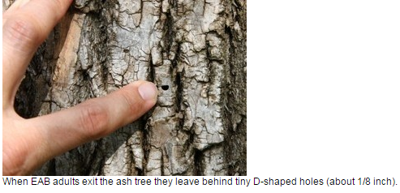
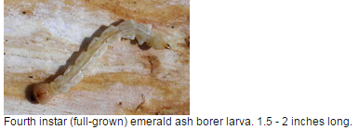
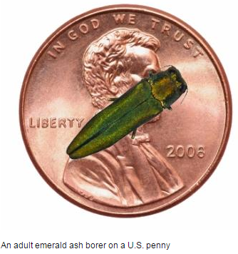
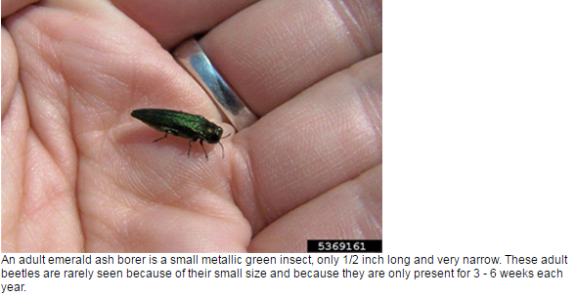

Slide 8
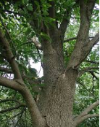
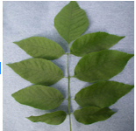
What does an Ash Tree Look Like?
1. It has an opposite branching pattern (two branches come off the main stem, one on each side and directly opposite each other) 2. It has compound leaves with 5-11 leaflets (depending on the species of ash). Leaflets are moderately toothed and may be stalked or sessile. 3. In winter: first look for the opposite branching pattern and stout twigs of ash. Small branches grow off larger branches opposite one another. Likewise, buds and leaf scars are opposite one another on twigs. Next, Ash trees have many small dots (vascular bundles) on their leaf scars, forming a semi-circle or crescent pattern. And, white and green ashes have thick, diamond-patterned bark, while black ash bark is thin, ashy-gray, and scaly.

Slide 9
Where has EAB been found?
EAB was first discovered in North America near Detroit, Michigan in 2002. Since then the beetle has spread to Canada and more than a dozen states, including Wisconsin. Emerald ash borer was found for the first time in Wisconsin in August 2008 near the community of Newburg, several miles northeast of West Bend. Since then, EAB has been confirmed in many counties. However, more of Wisconsin is still free of emerald ash borer than not. Most counties where the pest has been found have only small areas of infestation. That is why it is still so important to follow quarantine rules and to limit the movement of ash wood and raw ash products. By taking these precautions, we slow the spread of emerald ash borer to the northern forests where most of Wisconsin's ash trees are, and also slow the spread in the south.
See map on next slide.

Slide 10
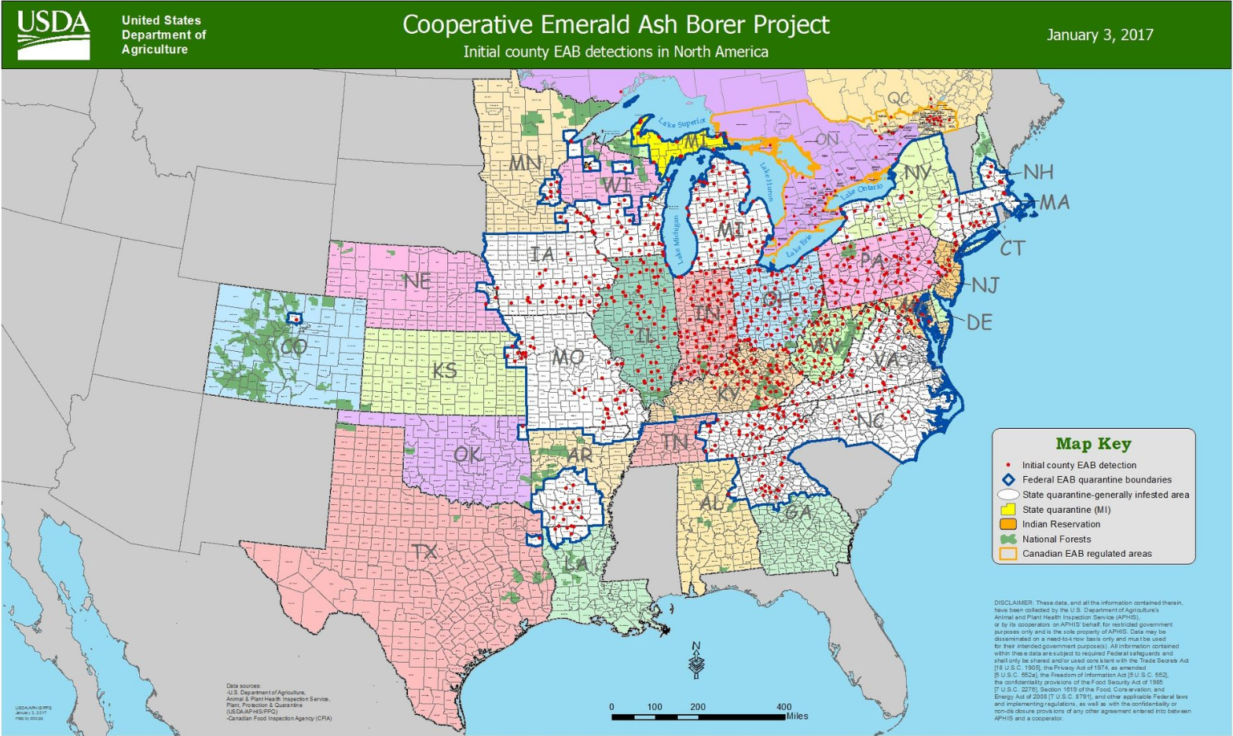

Slide 11
For Homeowners
With the arrival of the emerald ash borer and its potential threat to ash trees, the goal of any urban forest is to achieve tree diversity. No one more than 20 percent of one kind of tree should comprise the total urban forest population. Diversity should be planned for both public and private landscapes.
Whenever making the choices for emerald ash borer (EAB) prevention and management decisions, homeowners and commercial industries should review the latest decision-making tools available to them. University research results suggest that some treatment products and methods are effective when made appropriately, although there is some uncertainty of the long term effectiveness.
If you have an EAB-infested tree that you would like to use as firewood, be aware that EAB can continue to emerge from the wood for two years after cutting. To avoid spreading EAB, split and leave the wood to age near where you cut the tree for two summers. After two years of drying, EAB that may have been within the wood will have emerged or died. The aged firewood poses little risk of introducing EAB and you may move it freely within the limits of the quarantine.

Slide 12
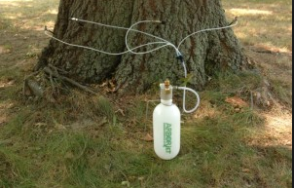
Is my ash tree worth treating for EAB?
http://hort.uwex.edu/files/2014/11/Is_My_Ash_Tree_Worth_Treating_for_Emerald_Ash_Borer.pdf

Slide 13
What is Wisconsin doing about EAB?
Although EAB beetles can fly a few miles on their own, they mainly spread to new areas with the help of people. Hitching rides in materials that people move, EAB can spread quickly. Some of the most important steps Wisconsin is taking regarding EAB include: 1. Raising citizen awareness 2. Restricting the movement of firewood and materials that could potentially carry EAB into new locations. 3. Monitoring for evidence of the insect

Slide 14
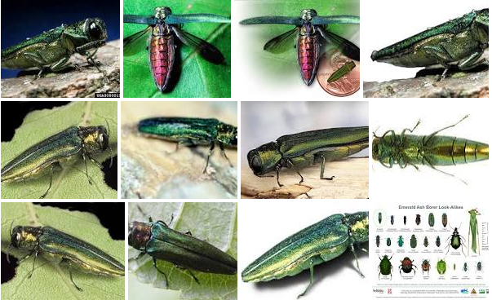
Questions?

